Slide 1
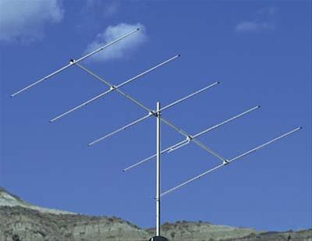
Amateur Radio Logging Software Training
Presented by-- KD9WRY & KD9RMZ

Slide 2
Events and Contesting
Events: Iola Bump & Jump, Field Day, SET Day, Waupaca Triathlon, Build Days
Contests: WI QSO Party, Parks on the air (POTA)
QSO Parties:
Exchange information dictated by contest rules
Make Contacts *** Earn Awards
Parks on the Air (POTA):
Test your equipment in outdoor parks
Promote emergency awareness and communications from national/federal and state/provincial level parks
13 Colonies, 10 Meter, and other contests
Honors original 13 colony states, our independence, and active military and veterans.
Iola Bump and Jump
Talk to Chuck if you can assist.
Build Day (TBD)
Open Discussion about possible date and time
Field Day: (June 24-25, 2023)
Learn what works/what needs improvement – test equipment.
Awareness to Public
Please sign up so we can try to cover the entire weekend of Field Day.
SET Day:
Practice relaying messages
Awareness to Public
Waupaca Triathlon:
Alert Net Control about bikers if they become injured, equipment breakdown
Report bikers without helmets to Net Control

Slide 3
More Reasons to Participate in Events and Contests:
Easy to make lots of contacts in a short time period.
Opportunity to receive awards for making contacts.
Your call sign will appear in print in contest results.
Improve your operating, logging, and propagation skills
Learn about the equipment and stations you operate.
Become Involved with other hams through communicating
and relating to operations.

Slide 4
Where Can I Find Events and Contests Information?
Group Leaders/Members
Internet
Amateur Radio Sites

Slide 5
COMMON LOGGING SOFTWARE SITES
Amateur Contact Log - N3FJP- http://www.n3fjp.com/
N1MM Logger - https://n1mmwp.hamdocs.com/
HAMRS (see slide later in presentation)
WriteLog - https://writelog.com/
TR Log - http://www.trlog.com
WinTest - http://www.win-test.com/
SI by EI5DI - http://www.ei5di.com/
DX Keeper - http://www.dxlabsuite.com/dxkeeper/
ADIF Master- https://www.dxshell.com/adif-master.html
eQSL- https://www.eqsl.cc
LoTW ARRL - https://lotw.arrl.org/lotwuser/default

Slide 6
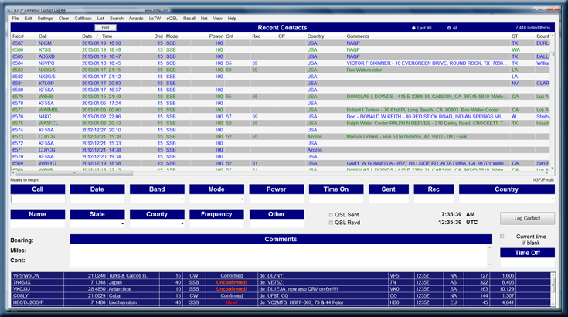
Very Easy & Intuitive to Use
Customizable User Interface
Software Package Options:
Full registration includes
Free registration of any additional amateur radio software they add to the package.
Free upgrades to existing programs
No annual/maintenance costs
Cost of $59.99 for a value of $400 of programs.
Image Source: -- https://www.n3fjp.com/aclog.html

Slide 7
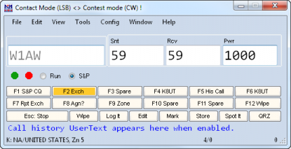
N1MM Logging Software Site
Most popular contest logging program
Used for CW, Phone, and Digital modes
Unmatched Contest-optimized features
Slide Source -- https://www.n3fjp.com/aclog.html

Slide 8
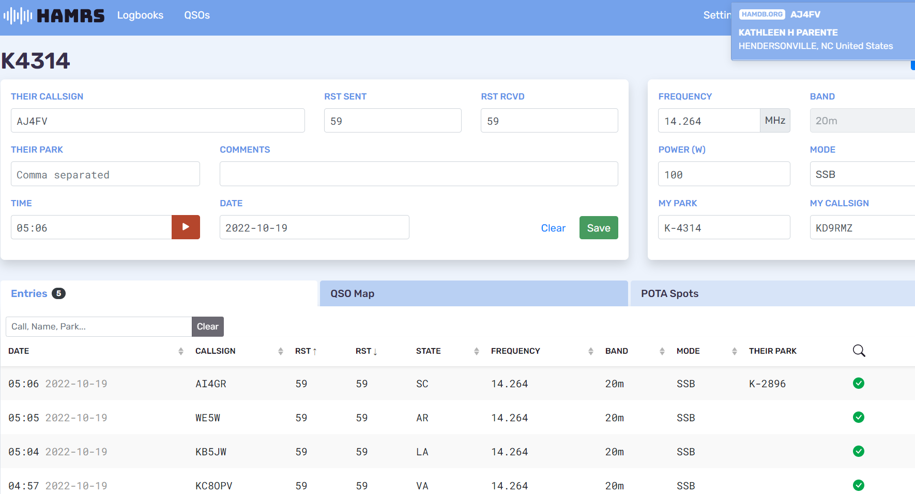
HAMRS LOGGING SOFTWARE APP
Easy as 1-2-3
1. Enter Your Info
Here
2. Enter Contact Info Here
3. Click Save

Slide 9
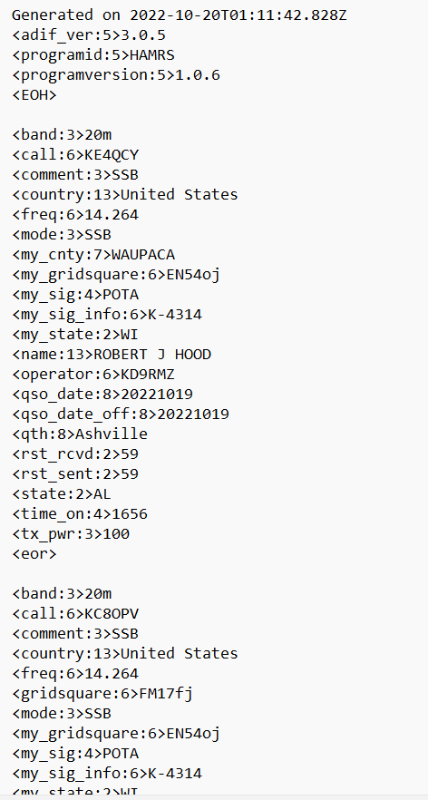
HAMRS EXPORT LOG TO ADIF FORMAT

Slide 10
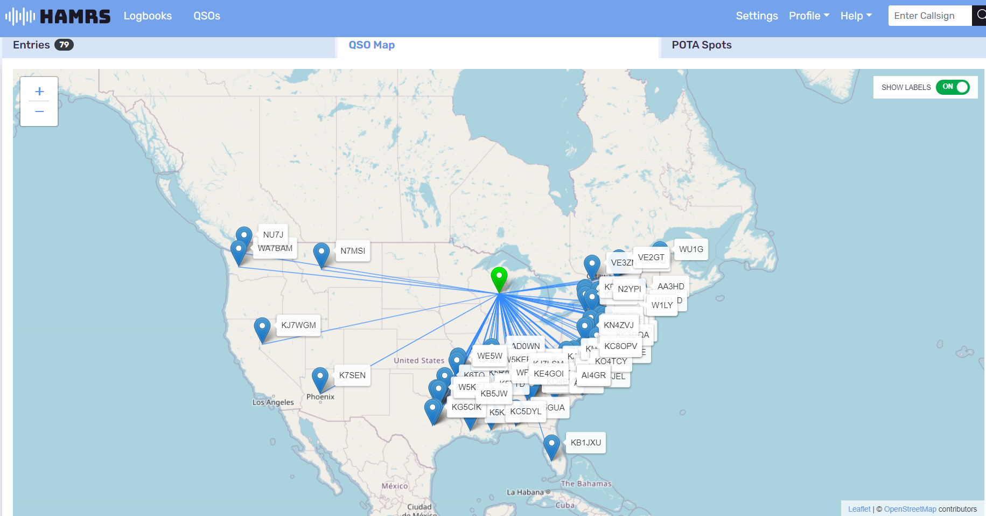
HAMRS QSO MAP

Slide 11
Two Essential Types of Information Logs Need:
Information about Your Operation:
Information about the Station You Contact:
Date
Frequency
Mode
Power Output
Call Sign
Time of Contact (Start/End)
Use UTC Time or Zulu
UTC Time is 5 Hours Past CST
Signal Report
Name and Location (QTH)
Source: http://www.arrl.org/keeping-a-log

Slide 12
POTA (Parks on the Air) Logs Need:
Per July 1, 2022 Announcement:
STATION_CALLSIGN This is the callsign you use on the Air!
Operator Your callsign…typically same as the station call
My_Sig_Info Your Park Number
Sig_Info P2P Park Number (Your Contact’s Park Number)
QSO_Date Date QSO event occurred
Time_On Time in UTC zone (5 hours past Central Standard Time)
Band Example: 20, 40, 80
Mode CW, Phone or SSB, FT8,etc.
Callsign Your Contact’s Callsign

Slide 13
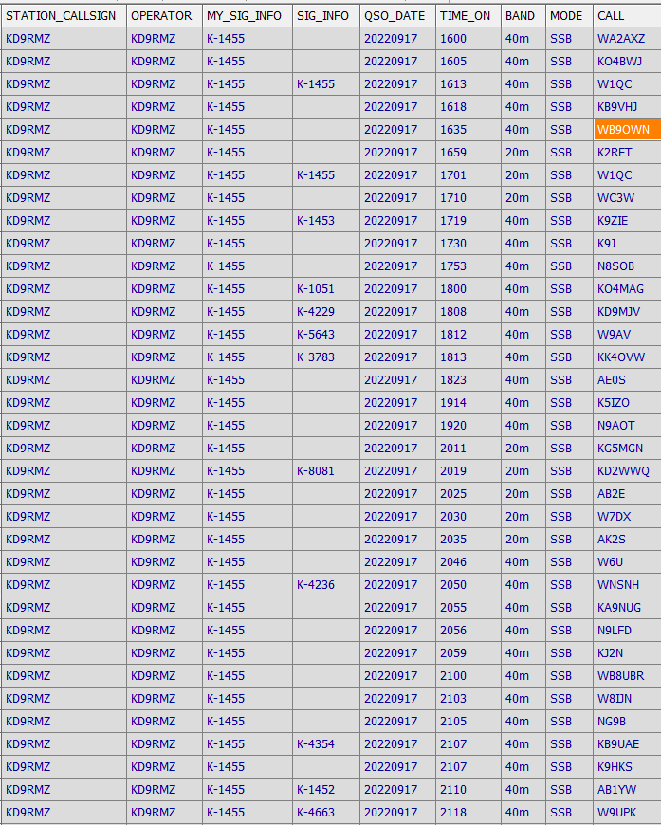

Slide 14
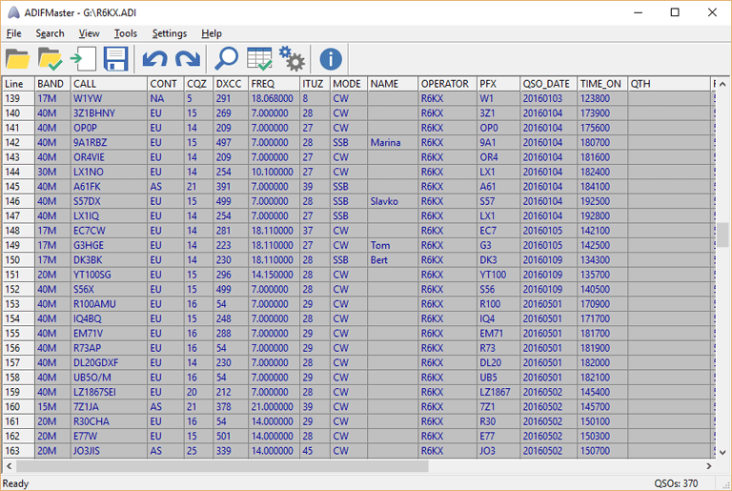
ADIF Master Logging Software
User-Configurable
ADIF Format Makes Transferring Easy
Converts Existing Logs into ADIF Format
Cabrillo
ADX (Azure Data Explorer (ADX) is a fully managed data analytics service for real-time analysis on large volumes of data streaming from applications, websites, and IoT devices. Azure Data Explorer (ADX) is a fully managed data analytics service for real-time analysis on large volumes of data streaming from applications, websites, and IoT devices.)
TR (https://www.trlog.com/newsite/history.shtml)
CT (CharlieTango – eham.net)
Slide Source:
https://www.dxshell.com/adif-master.html

Slide 15
How Are Contests Scored?
For most contests:
SCORE = Contact Points X Multipliers
Each contact receives a point value based on contest rules.
The Multiplier is determined by contest rules
i.e.
State/section
County
Country
ITU/CQ zone

Slide 16
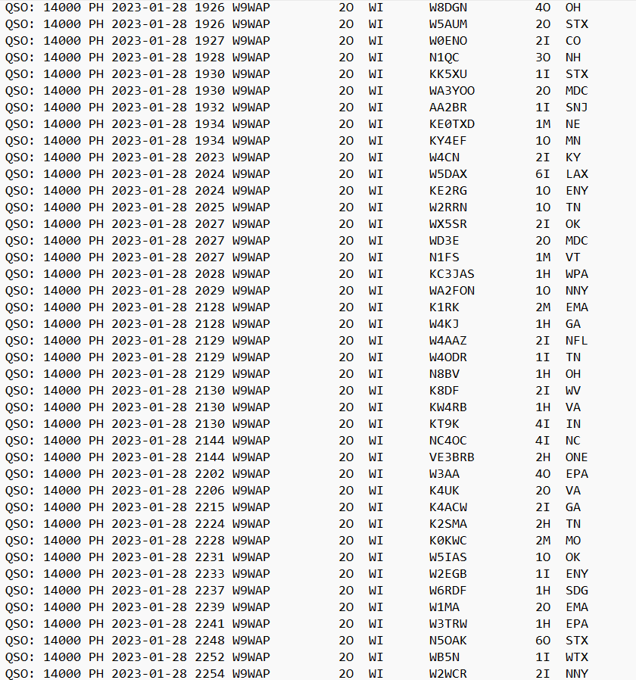
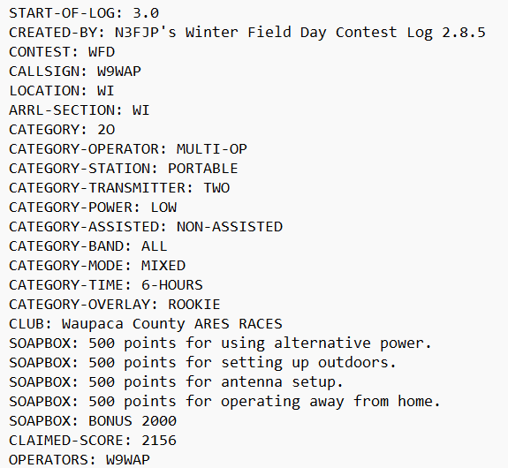
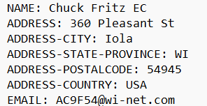
Winter Field Day Log

Slide 17
We Need Participants - Awareness in Parks and Events can possibly gain interest to the Public! Maybe we will get more members this way.
For group events and contests:
What’s Needed: Radio, Antenna, Logging software/sheet, Amateur Radio Identifiers (sign, etc.) and YOU!
REMEMBER to LEARN and LOG
Events
Contests
Nets
EARN AWARDS and NEW CONTACTS
Have FUN!

Slide 18
Comments or Questions
We hope you will find a logging software that works for your needs.
Congratulations to AC9F
For Winning Tonight’s
Meeting Door Prize:
An Annual WI State Park
Vehicle Admission Sticker
Good for 2023
Any Questions?

